Slide 1
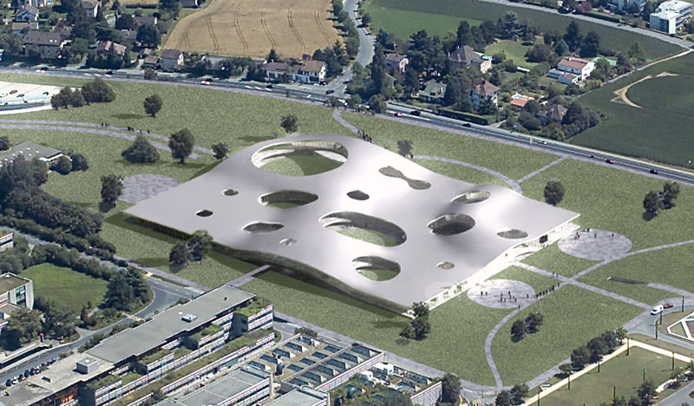
Micro-Positioners for Astrophysical Surveys
Philipp Hörler
Jean-Paul Kneib
EPFL,
Laboratoire de Systèmes Robotiques
Institut of MicroTechnology
02.03.2017

Slide 2
Outline
Project Introduction
Positioner Design
Electronic board
Collision avoidance
Test bench for performance assessment
Manufacturing strategy

Slide 3
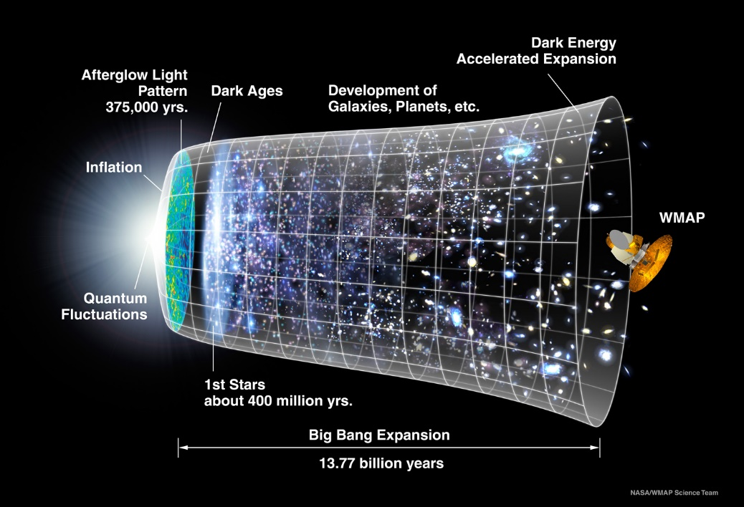
Context
History of the expansion of the universe
Recent acceleration => Dark Energy ?

Slide 4
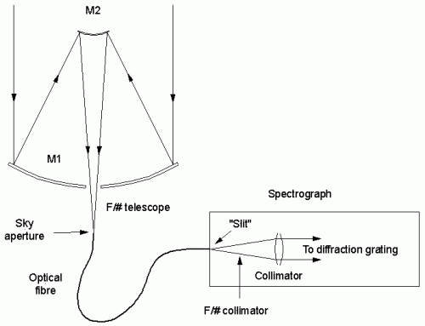
Context
The goal of many astronomical surveys is to measure the history of the expansion of the universe
For that a 3 dimensional map of the universe is measured
The distance of millions of objects is measured using the spectrum (redshift) of their light
Optical fibres allow for parallel measurements of thousands of objects at once
Spectrograph
Focal plane

Slide 5
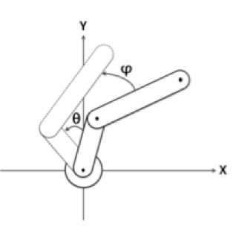
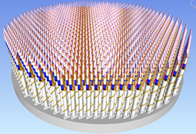
Context
A fiber positioner robot is a 2 DOF, planar robot with a SCARA like kinematic with almost parallel axes (curved focal surface)
Its purpose is to position an optical fibre which will collect the light of a star or a distant galaxy
To maximize the number of observable targets, thousands of positioners are mounted in a high-density array

Slide 6
Context
The 3 main projects in development today are PFS, DESI and MOONS
The astrobots group at EPFL contribute to all of them and is also planning future projects

Slide 7
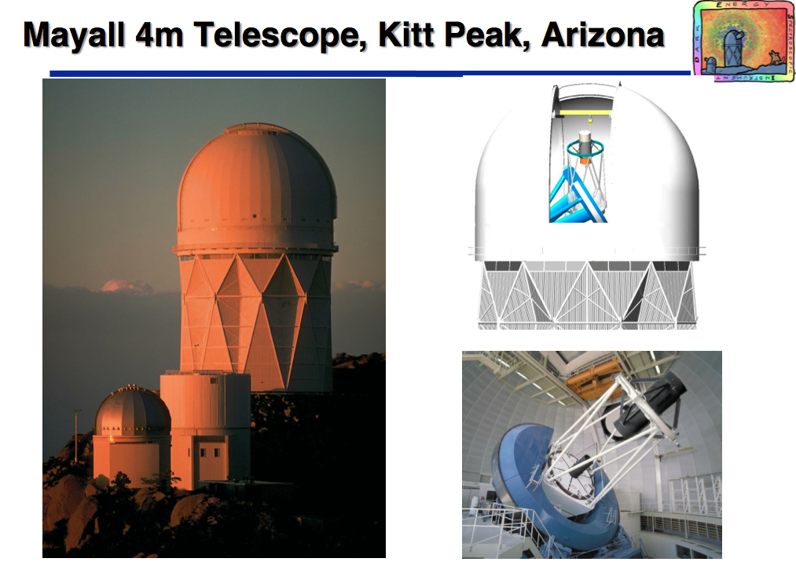
DESI
Focal plane

Slide 8
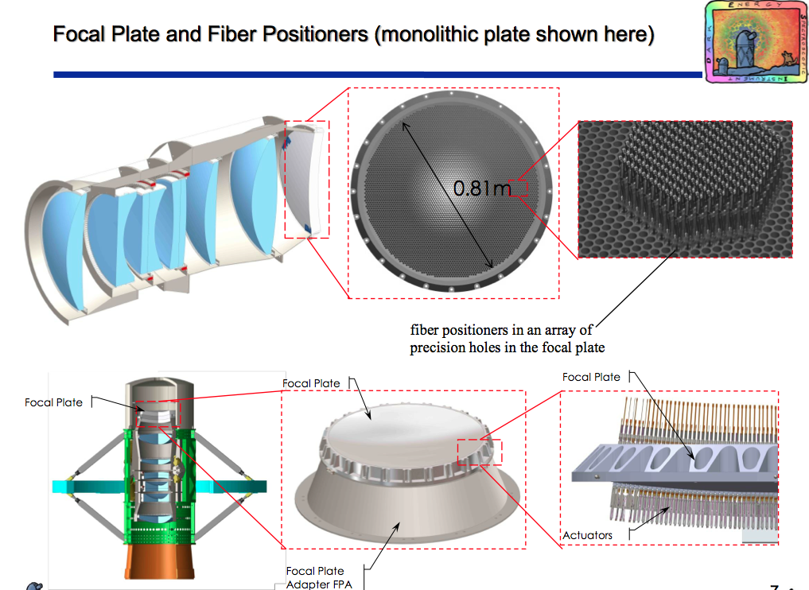
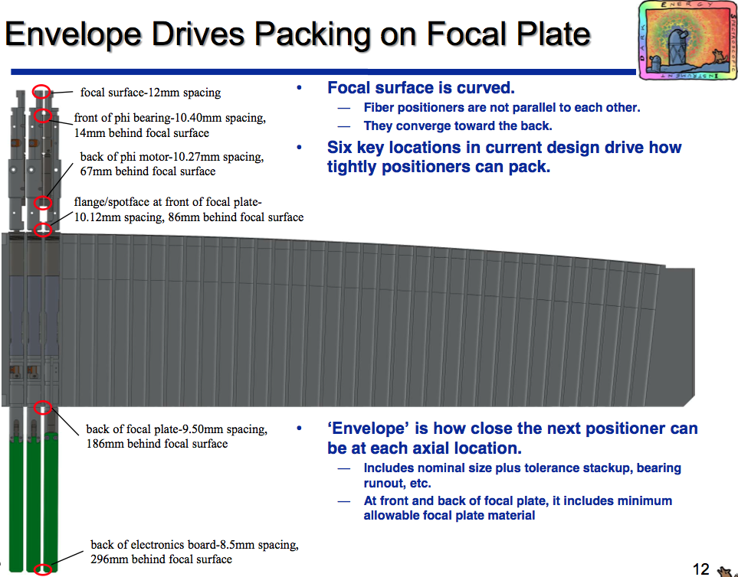
DESI

Slide 9
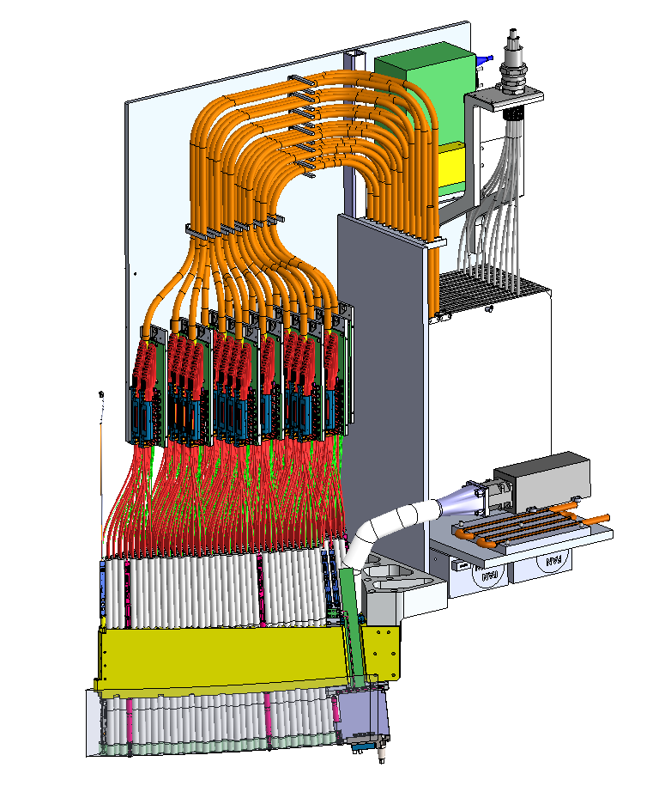
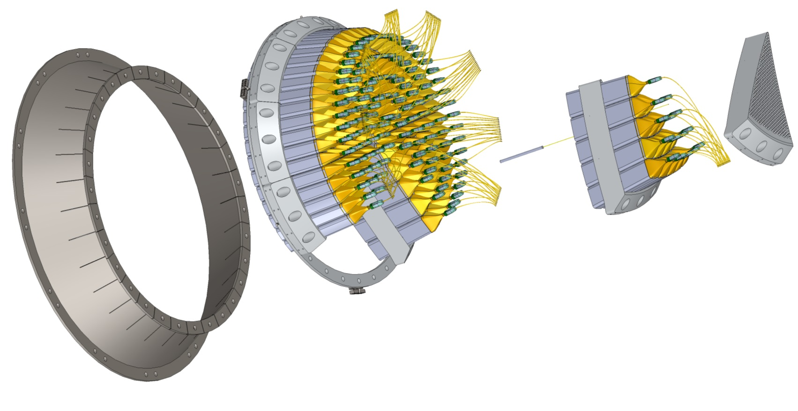
One focal plane petal
Fibre routing
Fibre and electronic
bundling
Fibre spoolbox
Cooling for GFA
Support plate
GFA sensor
500 Positioners
Focal surface

Slide 10
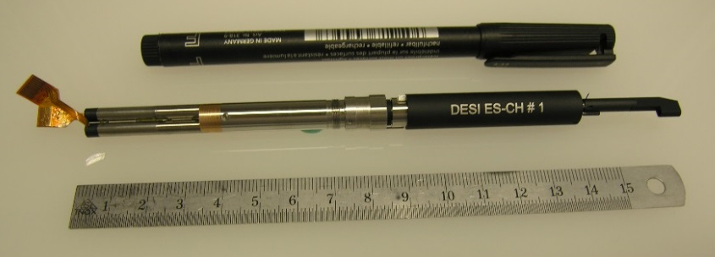
Prototype of the DESI positioner

Slide 11
Positioner requirements (MOONS Project)
Item | Requirement
XY Error accuracy/precision | < 20µm
Z Error (defocus) | < 70µm
Tilt Error | < 0.15°
Reconfiguration time | < 30 s
Throughput loss due to FRD | < 3%
Power while active | < 2W
Power while sleep | 0W
Lifetime | 10^6 targets / 10 years
Workspace | Annular shape, 50 mm OD, 18 mm ID
Risk of collision with adjacent fibres/cables | minimized
Challenges

Slide 12
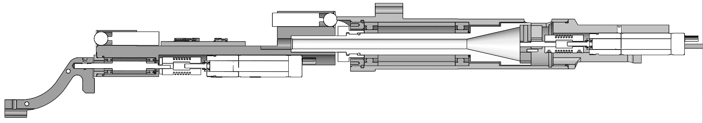
Tilt definition
Target angles
Tolerance: ±0.15°
β
f
f
0.24°
4m
0.11°
0°
g
β
α
α

Slide 13
Positioner requirements
XY error < 20µm
The XY error is the sum of the accuracy and precision
The accuracy can be very good (<5µm) thanks to calibration
Tilt error < 0.15°
The biggest challenge because it cannot be calibrated
Errors from all stages sum up
Throughput loss due to FRD < 3%
Happens because of stress in the fibre
=> Bending radius has to be maximized
=> Contact with sharp edges has to be avoided
Risk of collision with adjacent fibres/cables
As the upper stages rotate, the fibre and cables are moved
If they collide with adjacent fibres or cables, they can get stuck.

Slide 14
Outline
Project Introduction
Positioner Design
Electronic board
Collision avoidance
Test bench for performance assessment
Manufacturing strategy

Slide 15
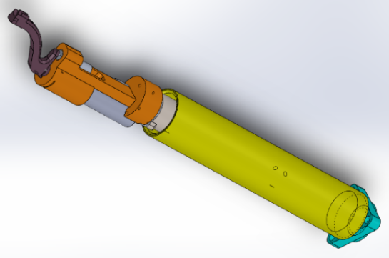
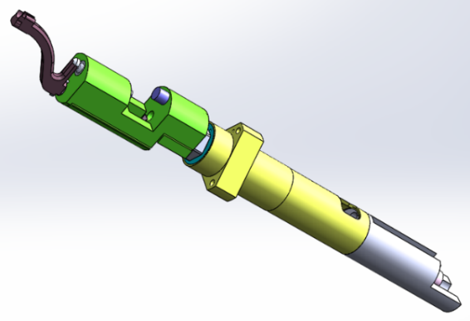
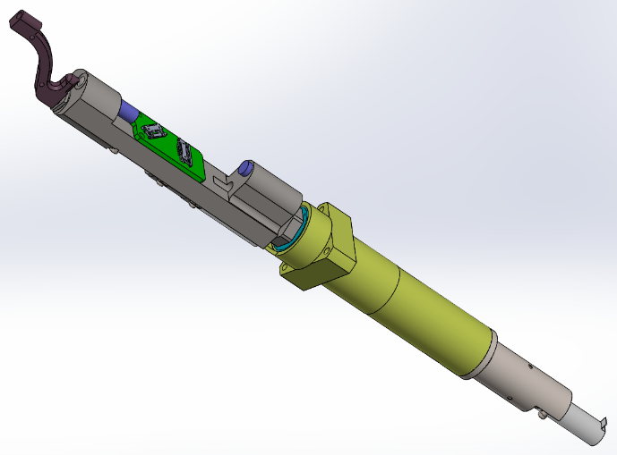
Positioner design history at EPFL
V1
V2
V3

Slide 16
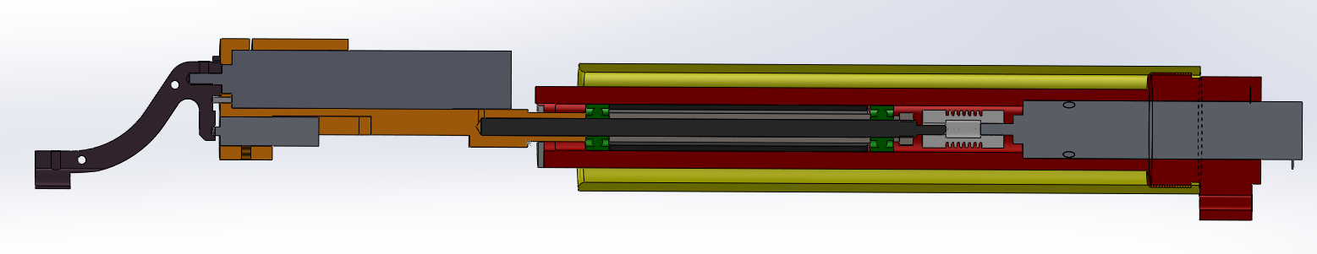
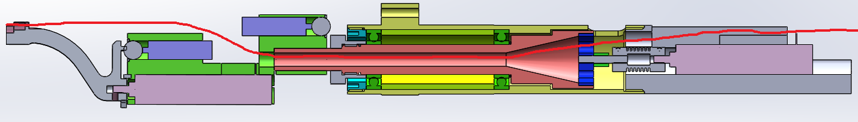
Design history - V1 to V2
V1
Fibre path is optimised
V2

Slide 17
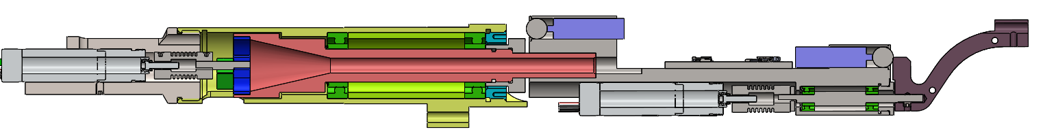
Design history - V2 to V3
V2
External bearings on upper axis
V3

Slide 18
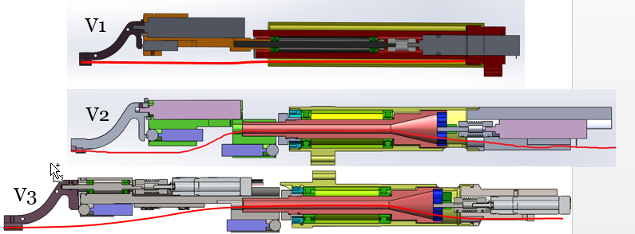
Design history – V1,2,3
V1
V2
V3

Slide 19
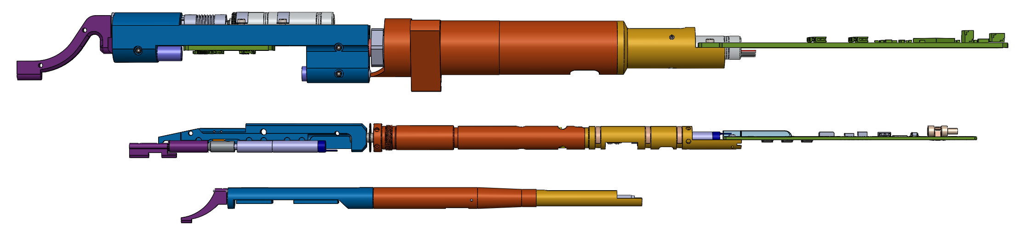
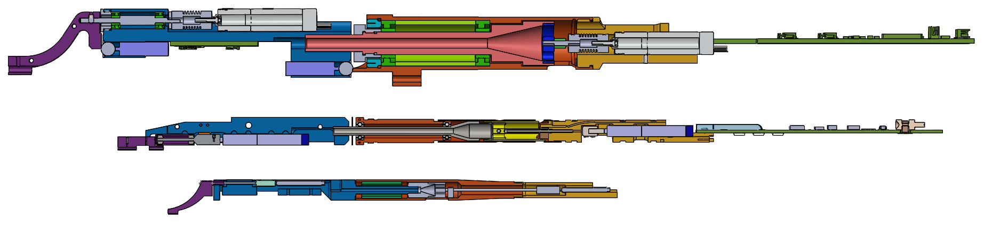
V3 Positioner
Beta hardstop
Ball bearings
Nut for preload
Alpha hardstop
Fibre
Motor coupling
Microswitch
Ball bearings
Lollipop feature

Slide 20
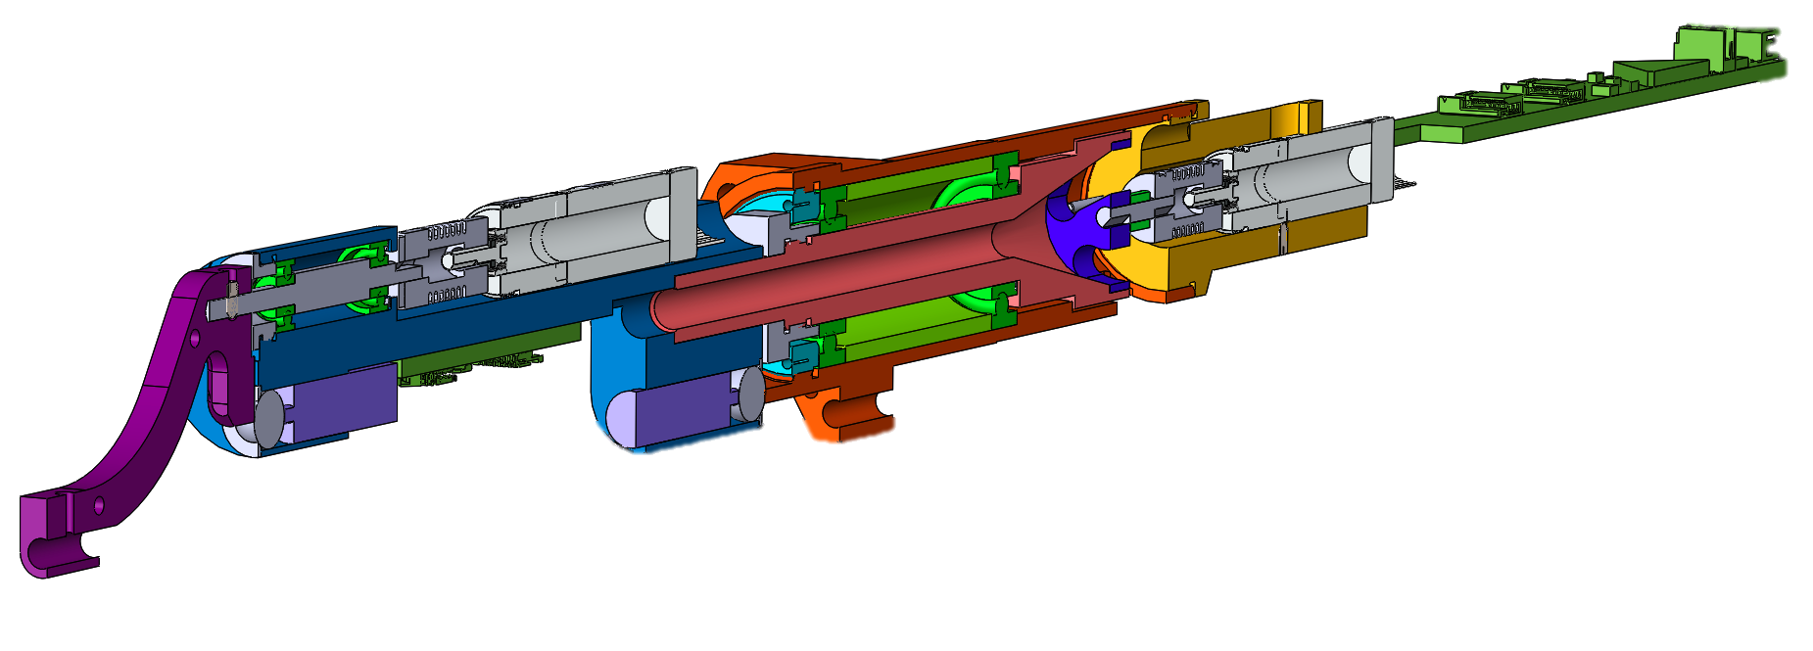
V3 Positioner
Alpha hardstop
Lollipop feature
Fibre

Slide 21
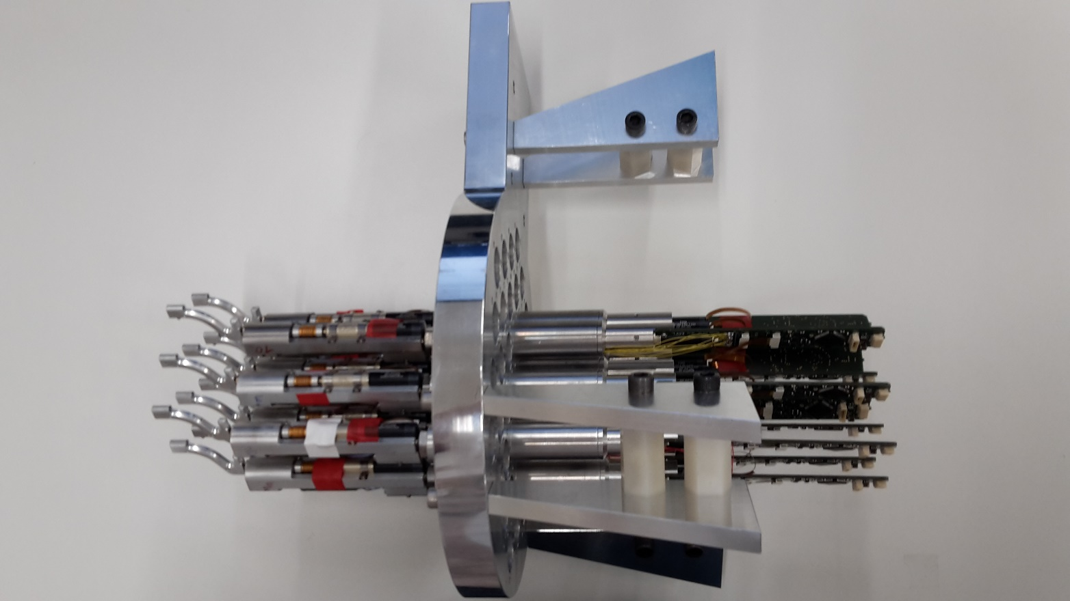
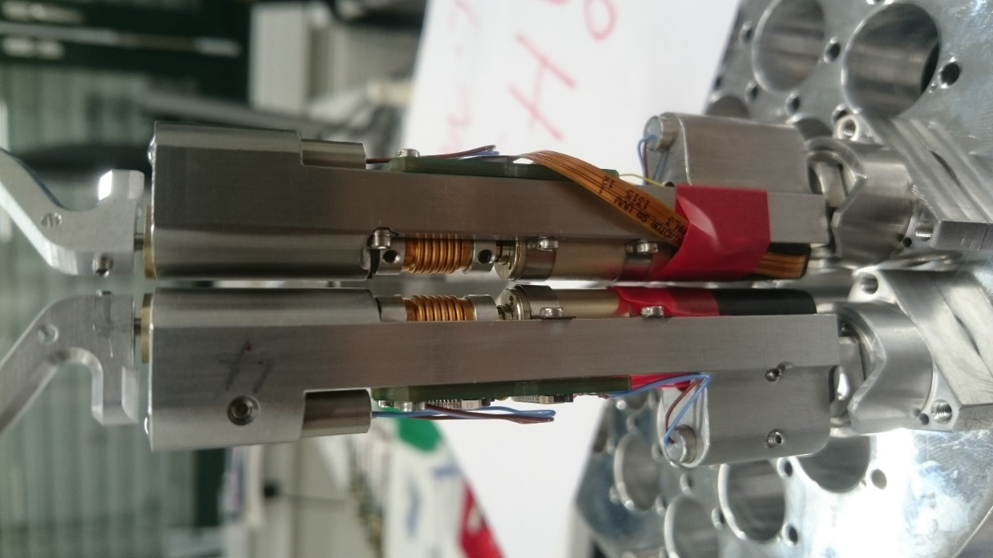
V3 Positioner prototypes

Slide 22
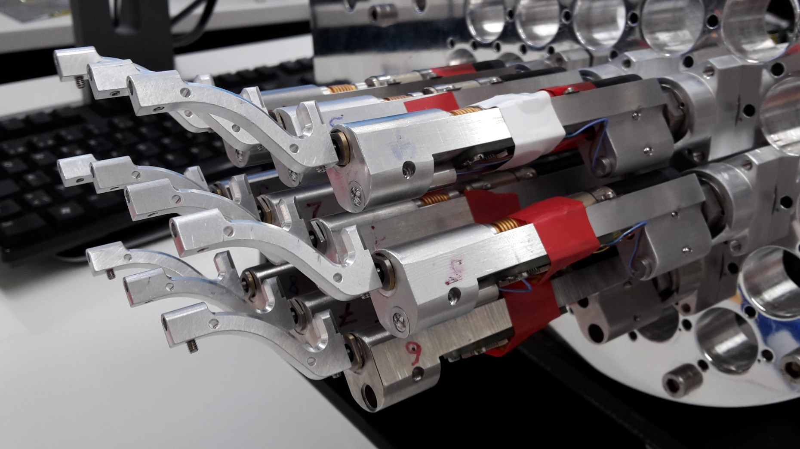
V3 Positioner prototypes

Slide 23
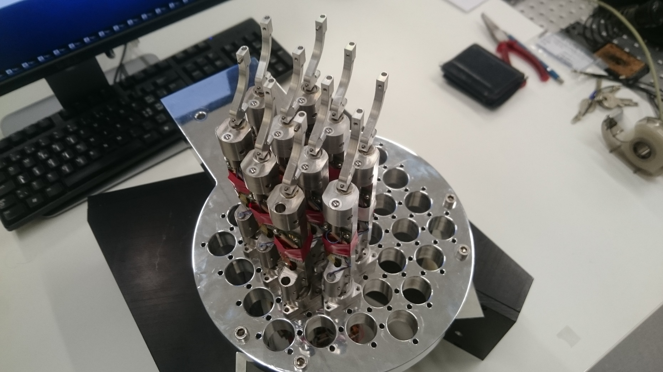
V3 Positioner prototypes

Slide 24
Outline
Project Introduction
Positioner Design
Electronic board
Collision avoidance
Test bench for performance assessment
Manufacturing strategy

Slide 25
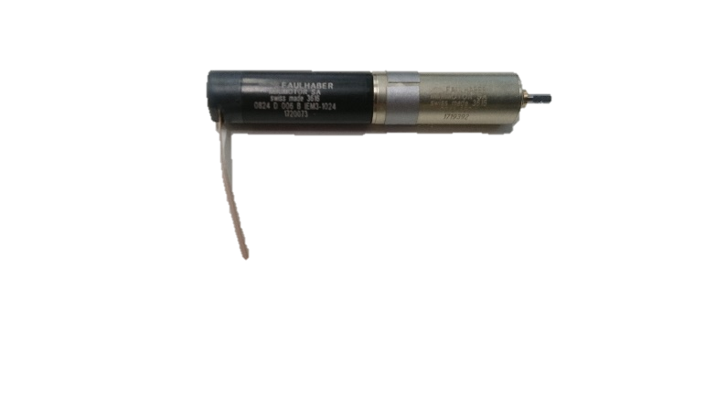
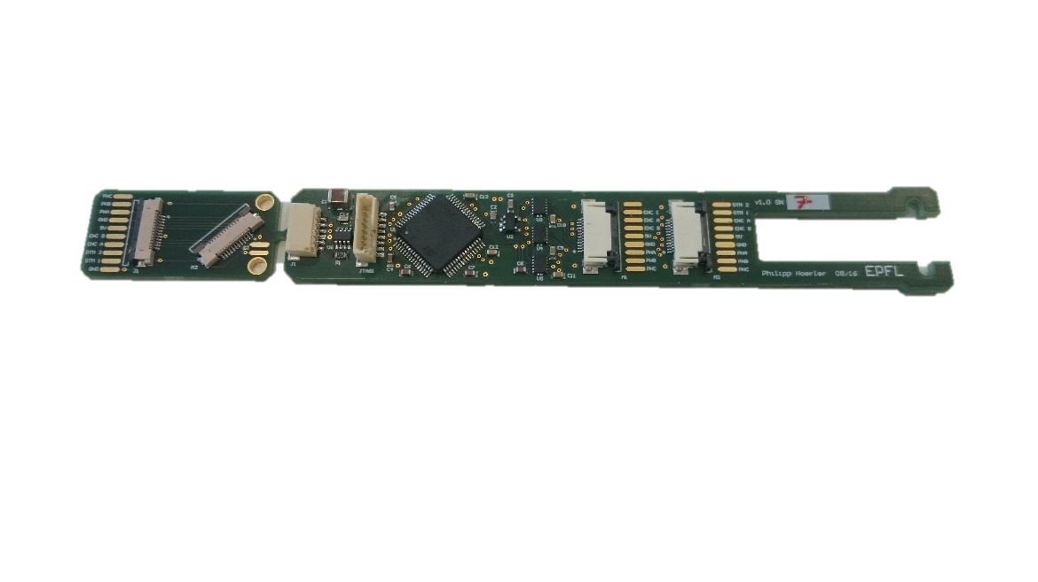
Drive electronic board
Complete motor driver for 2 DC brushless motor including:
Power electronic
Position controller: open or closed loop
Trajectory interpolation
Communication interface (CAN bus)
Key points
Power consumption
Space envelope

Slide 26
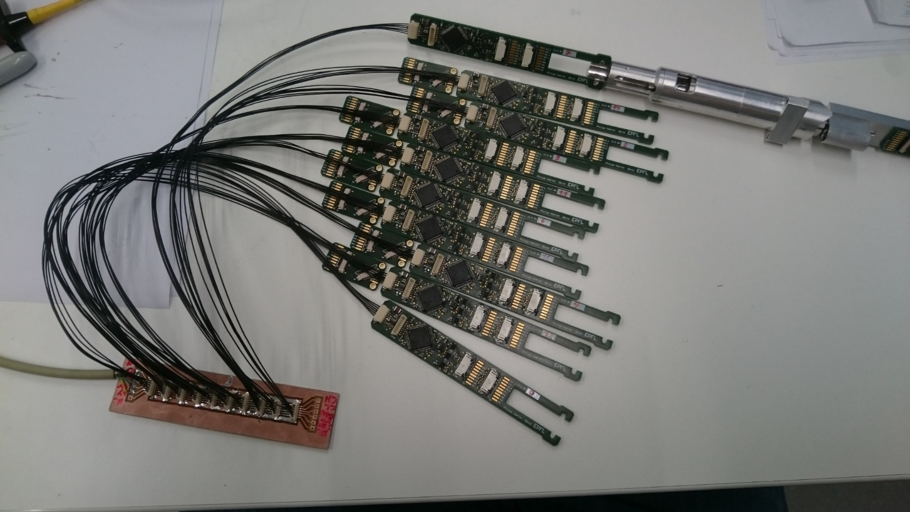
Drive electronic board - Communication

Slide 27
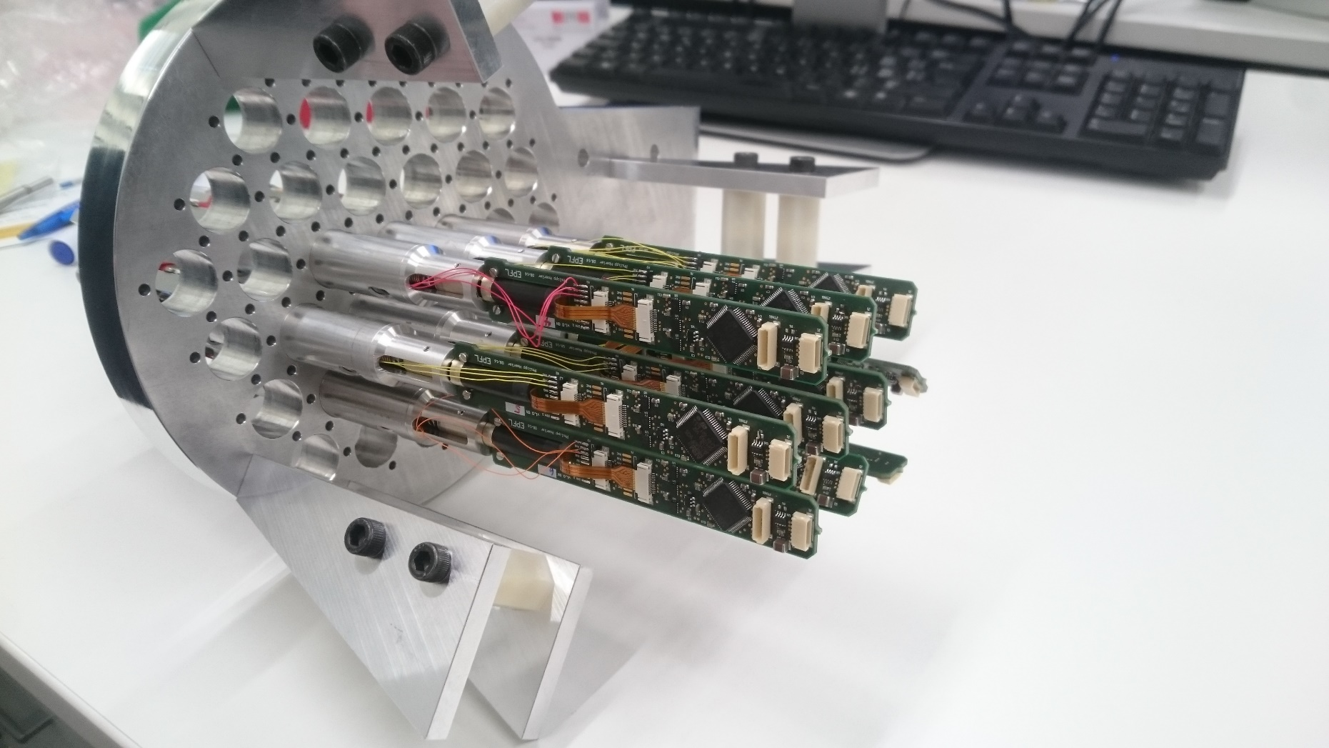
V3 Positioner prototypes

Slide 28
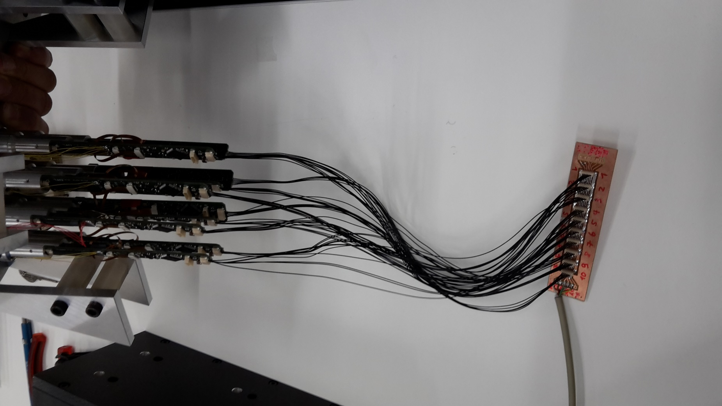
Electrical connection

Slide 29
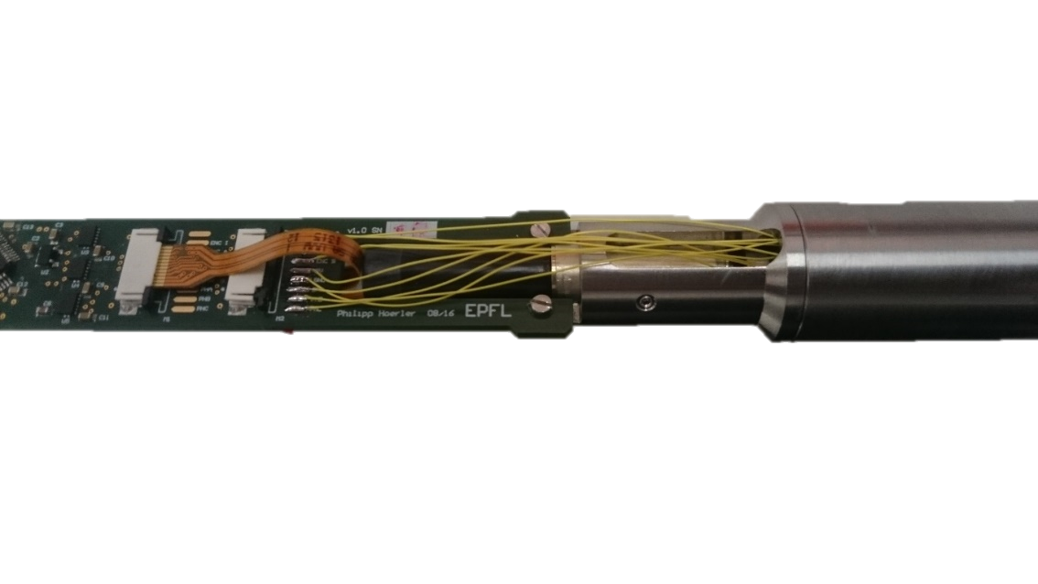
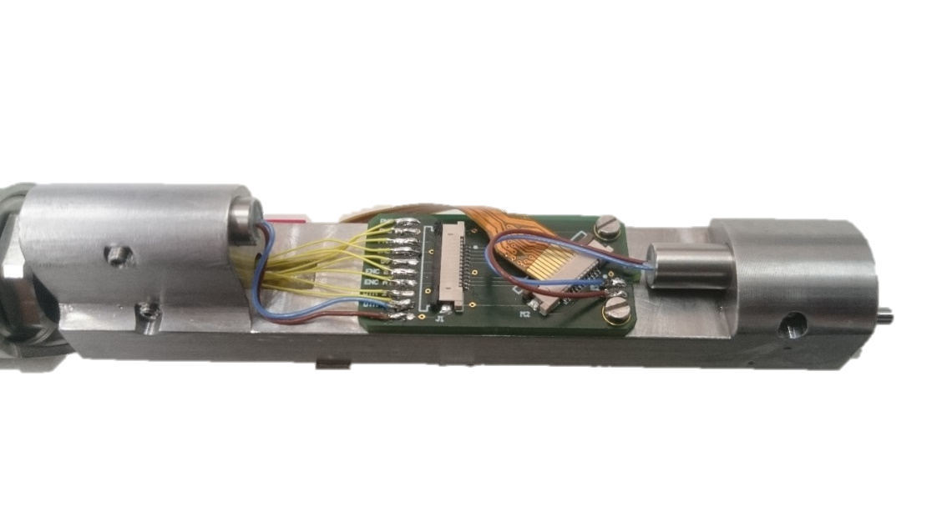
Cabling

Slide 30
Outline
Project Introduction
Positioner Design
Electronic board
Collision avoidance
Test bench for performance assessment
Manufacturing strategy

Slide 31
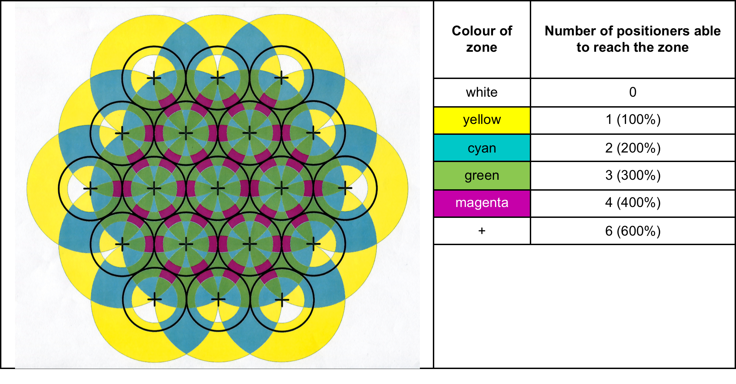
Shared work-spaces
0%
10%
63%
0%
27%
0%
0%
0%
Notes:
Magenta : 71.87mm2
Green: 169.51 mm2
Cyan: 29.26mm2
Total: 270.63mm2

Slide 32
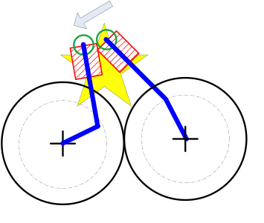
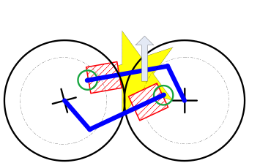
Challenges
Guarantee collision avoidance
Consider low planning and motion time
Take into account dynamic constraints

Slide 33
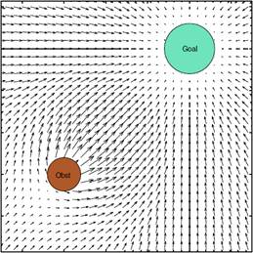
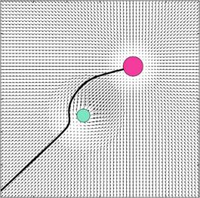
Solution
Artificial potential functions (Navigation functions)
Repulsive force from other positioners
Attractive force from the target

Slide 34
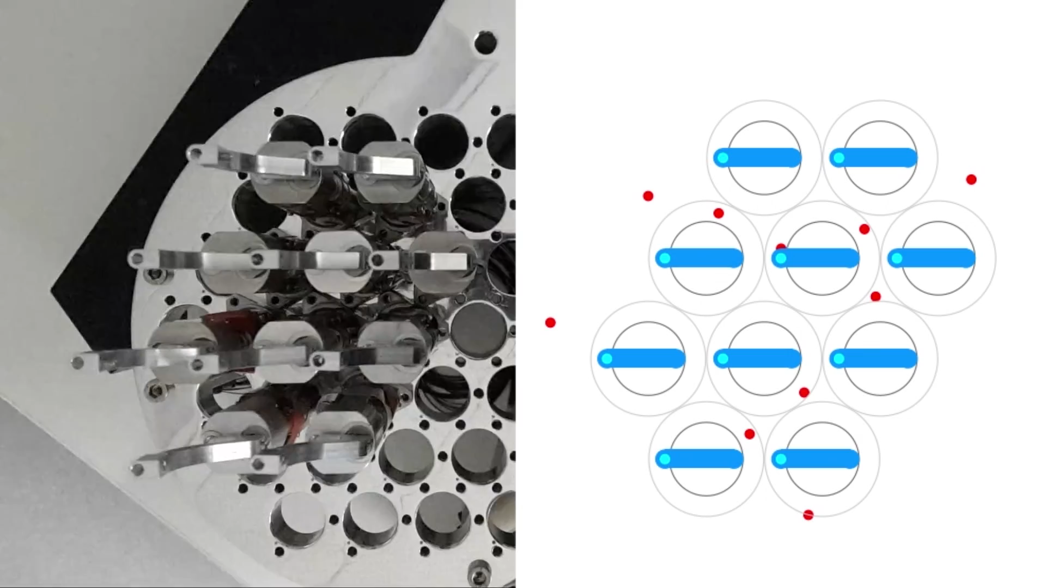
Test on hardware
https://www.youtube.com/watch?v=Hc_Pr_hhaNA

Slide 35
Outline
Project Introduction
Positioner Design
Electronic board
Collision avoidance
Test bench for performance assessment
Manufacturing strategy

Slide 36
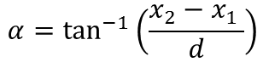
Metrology : Characterization Principle
Robot
α
Camera
x₁
x₂
Fibre
d
Screen
$$α=\tan^{−1}\left(\frac{x_{2}−x_{1} }{d}\right)$$

Slide 37
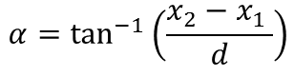
Metrology : Characterization Principle
Beam splitter
Robot
α
Camera
x₂
Fibre
Screen
Screen
x₁
$$α=\tan^{−1}\left(\frac{x_{2}−x_{1} }{d}\right)$$
Camera

Slide 38
Characterization Test Bench Calibration
Mirror
Beam splitter
Beam splitter
Baseplate
Camera
Screen
Screen
Pinhole
Align the laser on a mirror on the baseplate (our reference)
When the reflected beam goes back to the emitter, the laser is perpendicular to the baseplate and that is our reference
Laser
Camera

Slide 39
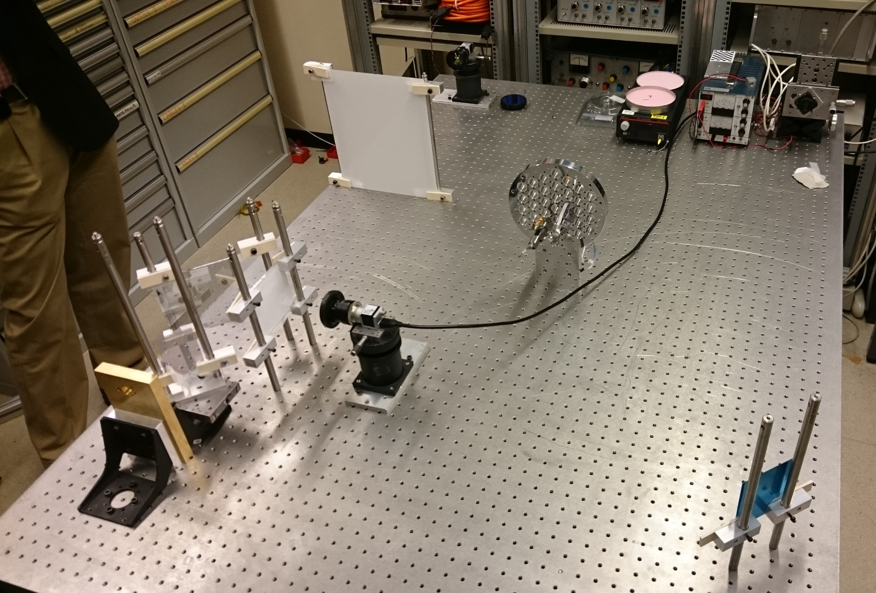
Tilt Test bench

Slide 40
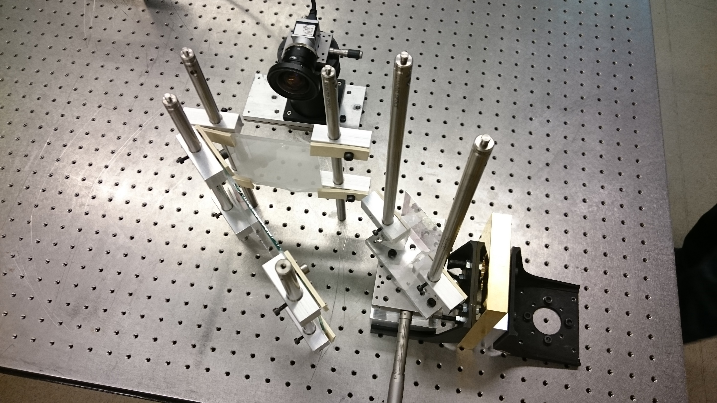
Tilt Test Bench : Reference calibration

Slide 41
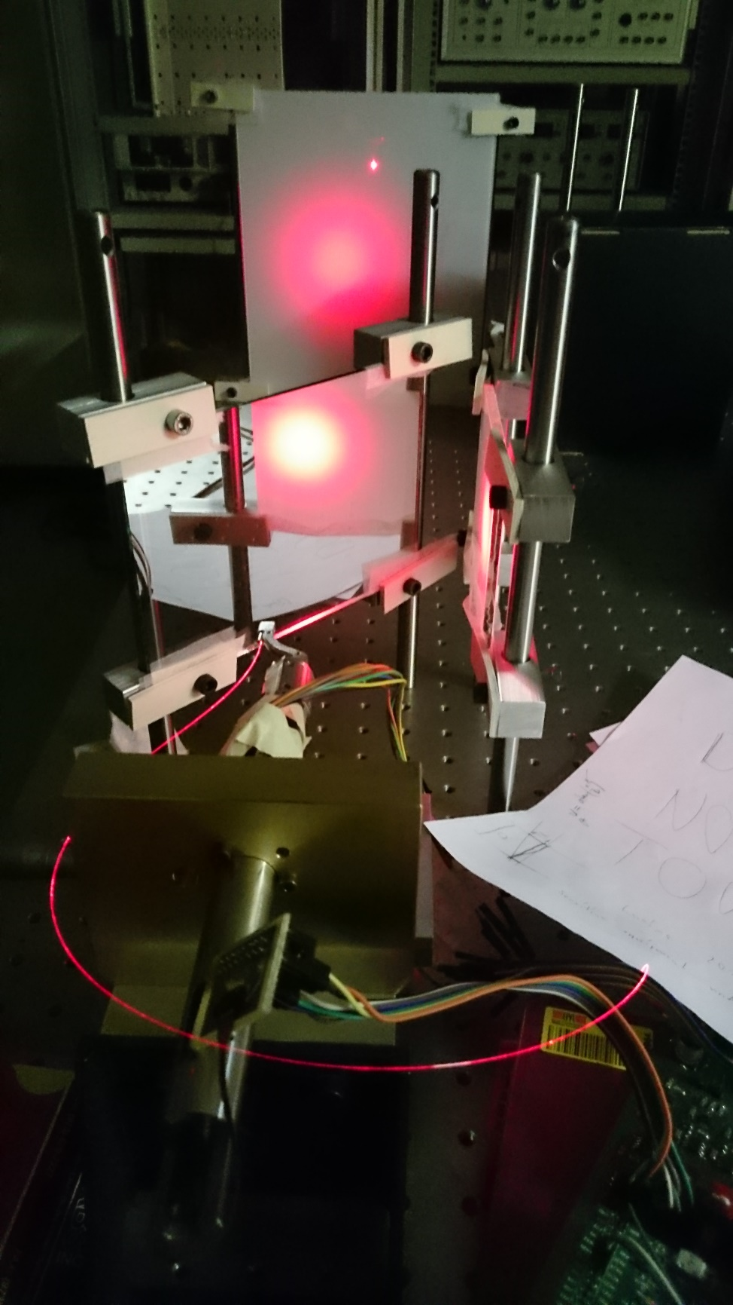

Slide 42
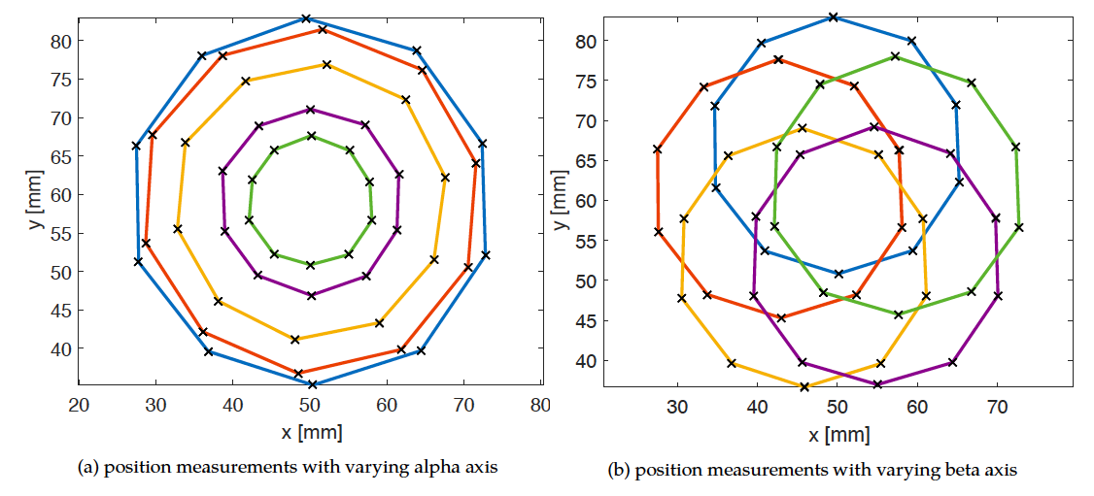
Test results

Slide 43
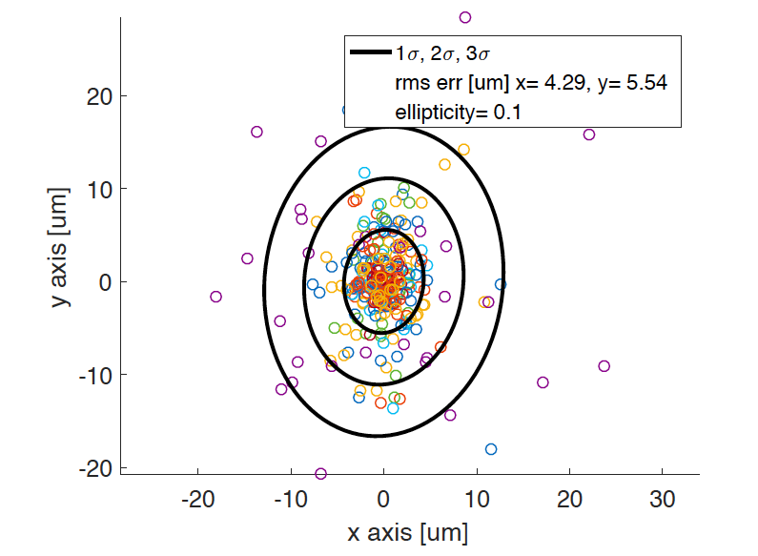
Position Repeatability

Slide 44
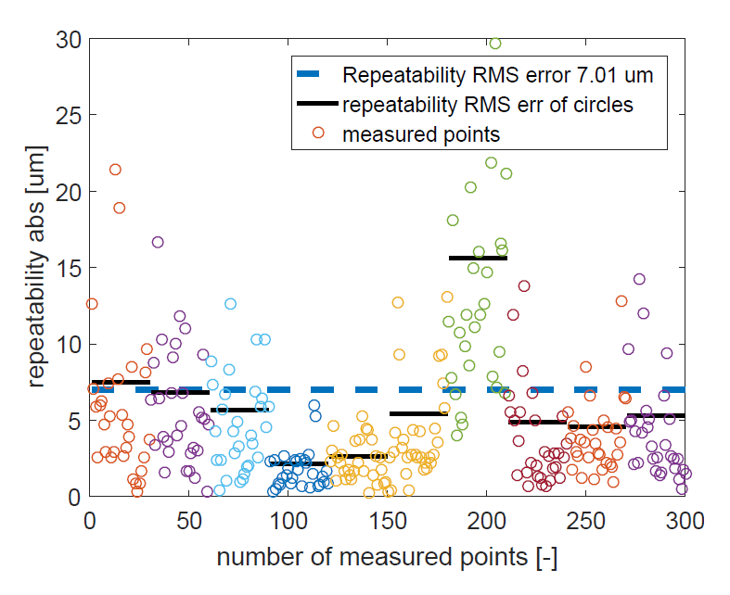
Position Repeatability

Slide 45
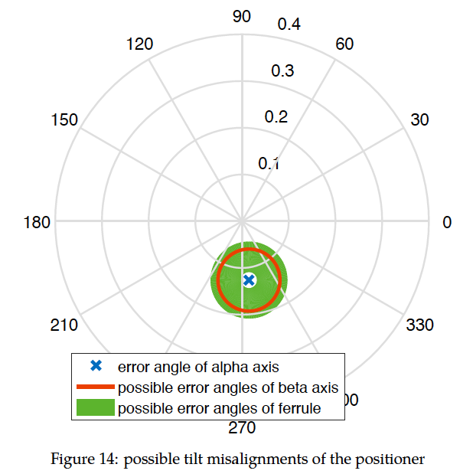
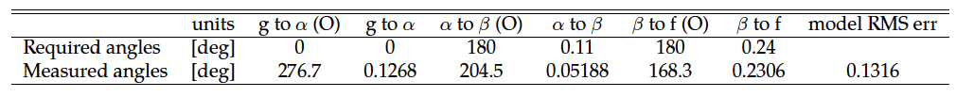
Tilt results
V3 Nr4
300 angles measured

Slide 46
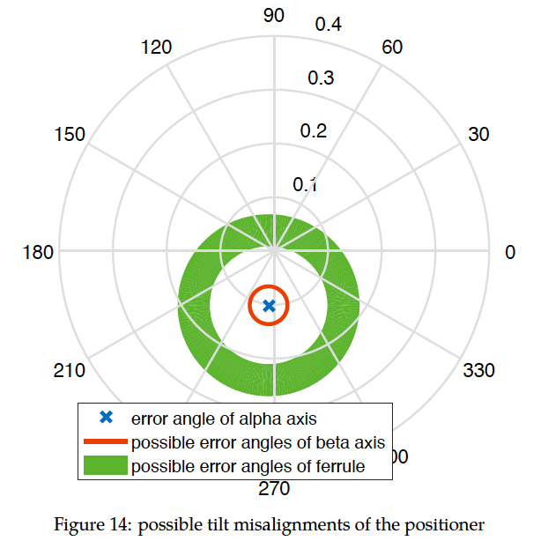
Tilts
V3 Nr4
V3 Nr6

Slide 47
Outline
Project Introduction
Positioner Design
Electronic board
Collision avoidance
Test bench for performance assessment
Manufacturing strategy

Slide 48
MOONS Positioner manufacturing
EPFL and STFC (Edinburgh) have made designs and prototypes
Final design review (FDR) of the design: End of March 2017
This liberates the funding for manufacturing
Public tender (issued following FDR) will include
Manufacturing of parts
Manufacturing or acquisition of drive electronic board
Assembly of the positioner
Quality assessment of the positioner
The public tender will not fix a mechanical design
EPFL and STFC designs will be given as reference

Slide 49
MOONS Positioner manufacturing schedule
Public tender for positioner design issued: April 2017
Public tender answer deadline: End of May 2017
Evaluations: June 2017
In discussion:
Preselection of 3 companies for prototype manufacturing: July 2017
Evaluations of prototypes: October 2017
Contract for manufacturing: July 2017 or November 2017
Goal of overall project: Assembly of 1000 positioners starting summer 2018

Slide 50

10 positioners demo move
https://www.youtube.com/watch?v=_S8JIjHawv0

